Slide 1
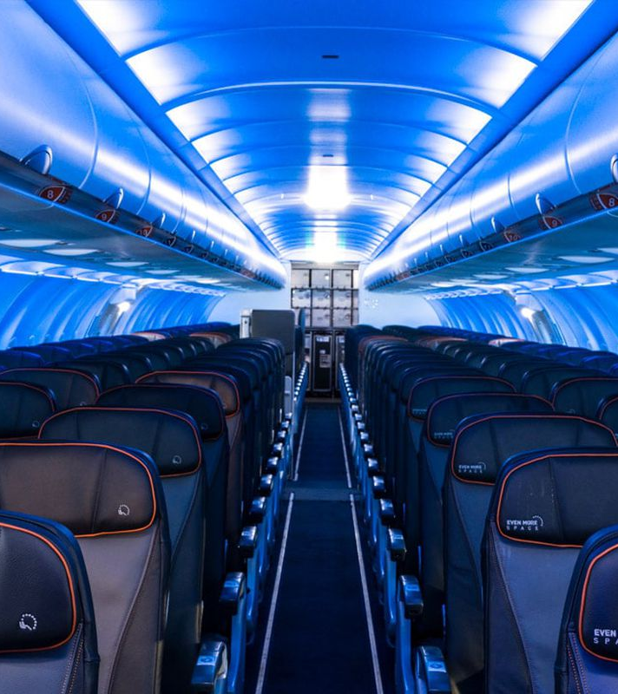
Predicting Airport Delays
ADS505
Team 4:
Hanmaro Song
Eva Chow
Jose Luis Estrada

Slide 2

Overview
Three major airports of New York have been experiencing flight delays, which impacts profitability negatively. As a result, business partners search for alternatives to mitigate the financial impact and create a strategy to increase profitability.
The scope of this analysis takes into account all flights from 2013 from all major airlines operating in the New York airports.

Slide 3
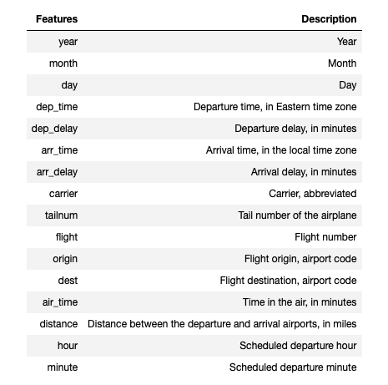
EDA
32,735 records of 16 variables
Suggested Dropped Variables | Suggested Predictors | Suggested Target
‘year’ ‘arr_time’ ‘arr_delay’ ‘tailnum’ ‘flight’ ‘dest’ ‘hour’ ‘minute’ | ‘carrier’ ‘month’ ‘day’ ‘dep_time’ ‘origin’ ‘air_time’ ‘distance’ | ‘dep_delay’
Notes:
Our dataset consisted of 32,735 records with 16 variables
Early on, we had some initial thoughts, as seen in the table, on some of the variables based on basic understanding of flight data and early observations made about the dataset
As all of the data collected was from the year 2013, we decided that dropping the ‘year’ variable would not have any impact on our models
Arrival time and arrival delay are highly correlated with departure time and departure delay, and as our objective was to try to predict departure delays, we thought that information regarding the flight arriving at it’s final destination may not be the most helpful for our model

Slide 4
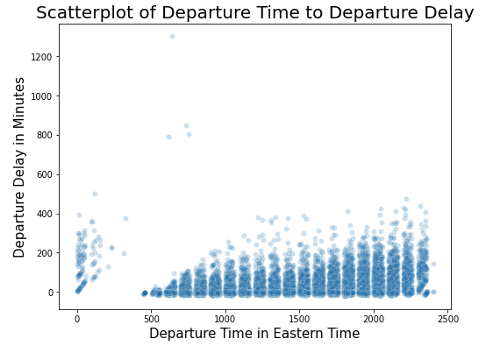
EDA (continued)
‘dep_time’, ‘hour’, and ‘minute’
‘dep_time’ is string combination of ‘hour’ and ‘minute’ variables
i.e. ‘dep_time’ of 1437 has ‘hour’ 14 and ‘minute’ 37
‘hour’ and ‘minute’ variables were dropped
‘dep_time’ was transformed into a categorical variable, where departure time has divided the 24 hour cycle into quarters
Dealing with Time Variables
Notes:
Addressed multicollinearity issues regarding ‘dep_time’, ‘hour’, and ‘minute’ variables by dropping ‘hour’ and ‘minute’ and categorizing ‘dep_time’
When plotting departure time against departure delay in minutes, we found that there is a steady increase in departure delay time as the day progressed after 5AM. This was followed by a sharp drop in departure delays as flight departures in the early morning also dropped in quantity
Data transformation was performed on departure time to further simplify departure time for modeling purposes
As departure delay in relation to departure time showed a general upward trend as time progressed, transforming the departure time should assist in model performance by simplifying this variable
Ultimately, we decided to transform departure time into quarters. These quarters are defined as midnight to 6AM, 6AM to noon, noon to 6PM, and 6PM to midnight

Slide 5
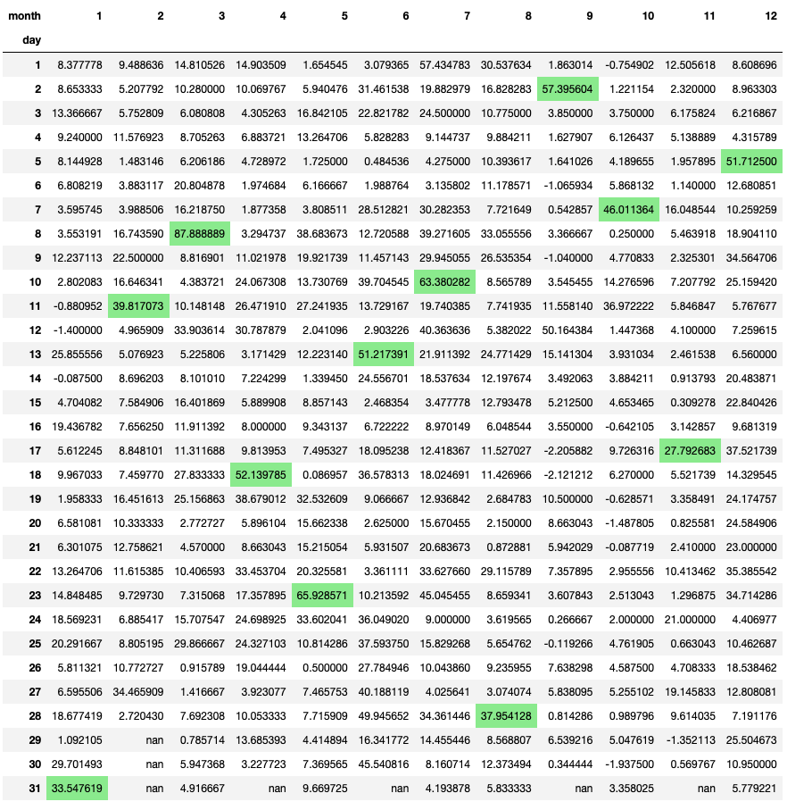
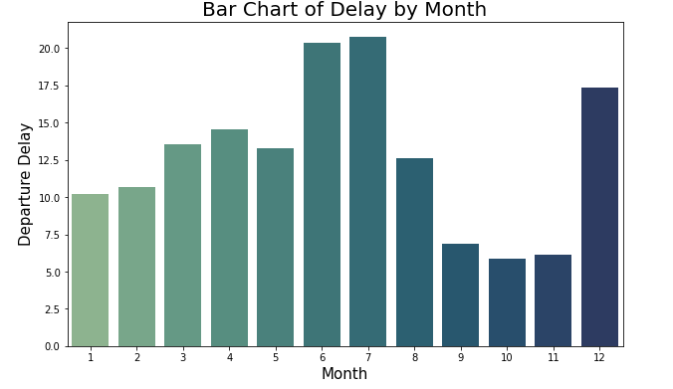
EDA (continued)
‘month’ and ‘day’
Dates (‘month’ and ‘day’)
Notes:
We continued our data exploration by examining month and day
When comparing how many flights occur per days of the month, the 31st day of the month showed a decrease in the number of flights, which can be attributed to the fact that only 7 months of the year have a 31st day
The number of flights per month ranged from 2200 to 2900 flights per month, with the lowest number of flights being in February, but this can be attributed to February being the shortest month of the year. Likewise, months with 31 days had more flights compared to months with only 30 days
Overall, data distribution for flights across the months and days were fairly evenly distributed
When plotting average departure delay by month, we saw a larger range in average departure delay, with a skew towards longer departure delays occurring in June, July, and December. Our initial thoughts were whether these longer departure delays are correlated with holidays, which would be assumed times of peak travel periods. This would mean holiday seasons, spring break, and the summer months may have longer departure delays, which is seen on the barplots
To visualize this further, we grouped days by month showing average departure delay over the course of a year, and as highlighted, we see that in each month, the days with the longest average departure delays occurred around peak holiday times
Most notably, we observed that:
Feb: before Valentine's day
Apr: spring break
May: Memorial Day
Sep: Labor Day
Nov: Thanksgiving
Dec: Peak delay occurs around Dec 5th, but note increase in average flight delay in the week leading up to Christmas

Slide 6
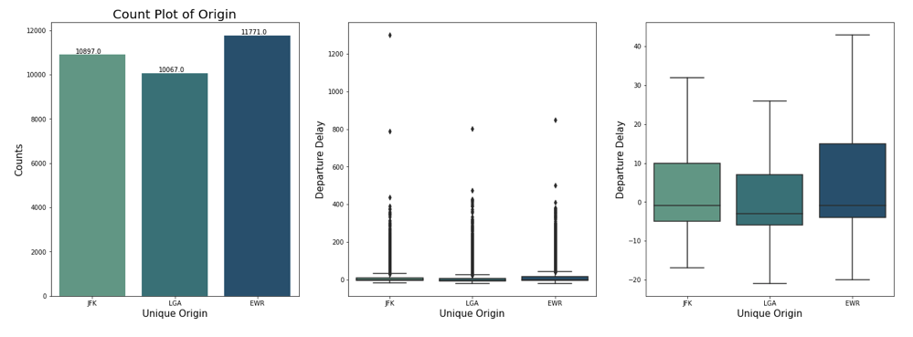
EDA (continued)
Notes:
An additional variable of note is the origin
As noted previously, the data gathered is from the three New York international airports
In the barplot, we note the distribution of flights across all three airports. Newark international airport exhibits the most flights, and LaGuardia international airport had the least amount of flights of the three
We then viewed departure delays per airport across a barplot. Without removing any outliers, the median for all three airports appears close to zero, with most of the delays occurring under 400 minutes
After removing outliers, Newark international airport appears to experience the longest departure delays, followed by JFK, then LaGuardia

Slide 7
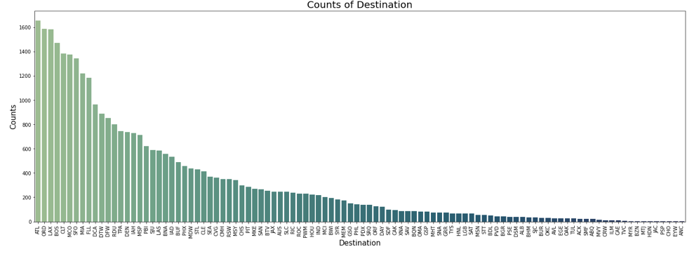
EDA (continued)
Why we dropped variables such as ‘tailnum’ and ‘dest’
Notes:
Early on in our data analysis, we were interested in dropping some variables
Some variables of note include tail number and destination
Tail number is the number on the tail of the plane and is unique to a plane that flies from these three airports
There are 3490 unique tail numbers within the observations, therefore, we opted to drop this variable due to the amount of unique values within this variable
This is similar to destination, of which there are 102 unique destinations that flights flew to. Although there aren’t thousands of unique values within the destination variable, the skew in the number of flights to each destination proved to be very uneven, further prompting us to drop this variable

Slide 8
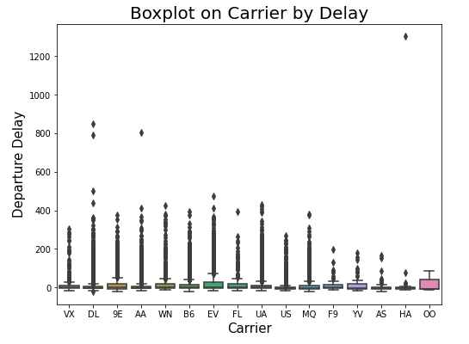
EDA (continued)
16 unique carriers
Range of delays varies across carrier
Departure delays for most carriers fall under 200 minutes, with almost all carriers having less than 400 minutes in departure delays when excluding outliers
Notes:
We then examined the carriers and whether they had any correlation to departure delay
We have 16 unique carriers, and as we can see by the boxplot, the median departure delay for most of these airlines is close to 0, but the range of delays within each carrier shows great disparity depending on the carrier
Across the carriers, a majority of them have delays of 200 minutes or less, with almost all carriers exhibiting delays of 400 minutes or less when excluding outliers
Although the distribution of flights across carriers is not even, with some carriers having thousands of flights and other carriers having only hundreds in comparison, the disparity in departure delay time across the carriers warrants keeping carrier as a variable

Slide 9
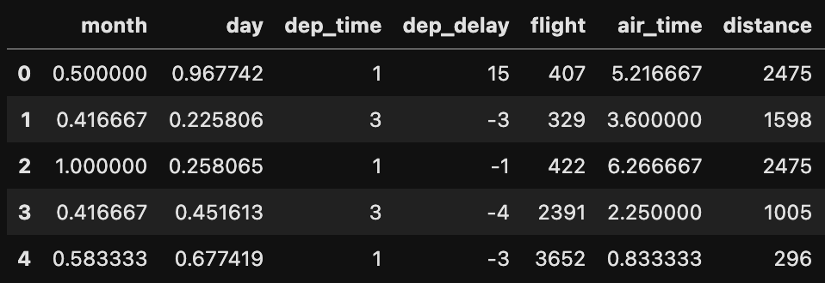
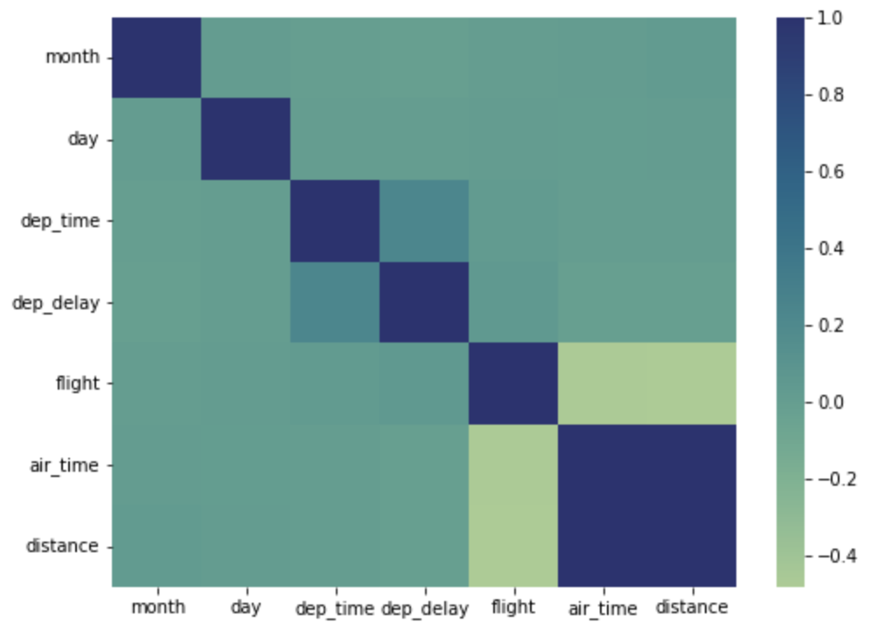
Finalized Data (Pre-processed)
Data Overview
Correlation Plot
Notes:
Again, features that have been dropped are year, hour, minute, arr_time, arr_delay, tailnum, flight, and dest.
Among those remain, Month, Day, and Air Time features have been normalized.
Month was divided by 12 which is the maximum value in months while Day was divided by 31.
Air_time has been converted into hours.
Distance is in miles and this has not been normalized.
Departure time has been converted into 4 discrete values from 0 to 3, which represent 24 hours divided into 4 sections.
By looking at the correlation plot on the right side, most of them quite have neutral relationship among them. But we can see very high correlation value between air time and distance which makes sense since the farther the distance is between point A and point B, the more time it takes to get there. However, it may not be so wise to drop either of them as it is possible that even a short distance takes longer-than-usual air time depending on air traffic at a destination.

Slide 10
Data Distribution & Split
Total of 32735 Data points
25430 long_delay = 1
7305 long_delay = 0
1000 data points from each long_delay for test datasets
Ratio of 3.48 : 1 ( Class Imbalance )
Resample data with SMOTE-Tomek and 5-fold Stratified Cross Validation
Notes:
There are total of 32735 data points among which are 25430 long delay. Long delay indicates flights that have departure delay of equal to 15 minutes or longer than that.
Because the ratio of y values are 3.48 to 1, naively sampling for train and test dataset might cause a problem where train dataset contains very low number of long delay of 0 values.
So what’s been done is sampling 1000 random data points from each long delay values so that the test datasets of 2000 records are exactly comprised of equal number of those y values.
When training models, to overcome the problem of class imbalance, although it is not as severe as other problems such as credit card fraud detection, Smote-Tomek algorithm for resampling with 5-fold stratified cross validation were used.

Slide 11
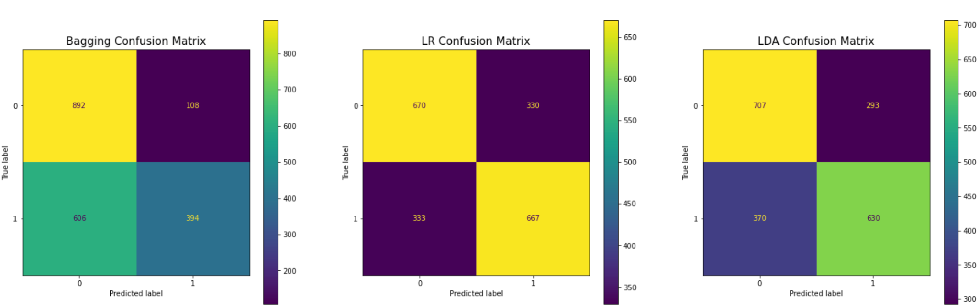
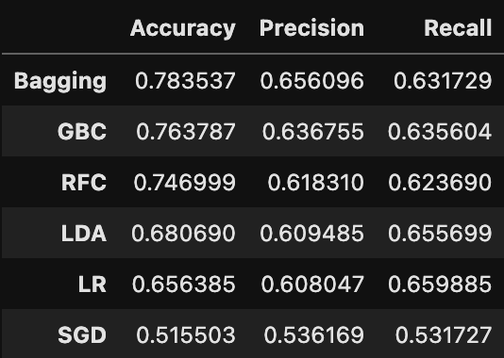
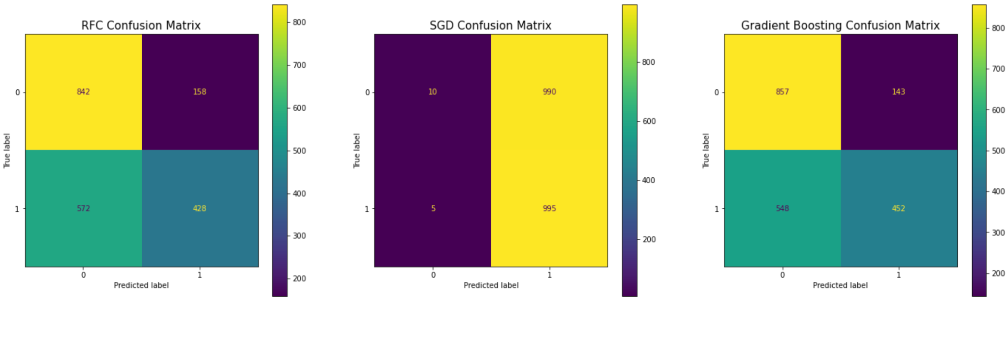
Model(s) Implementation & Evaluation
Notes:
Total of 6 models have been implemented and evaluated which are
Bagging classifier with a base model of decision tree, Gradient Boosting Classifier, Random Forest classifier, linear discriminant analysis, logistic regression and support vector classifier.
Among them, Bagging classifier has been proved to be performing the best out of all with .78% accuracy and .65% precision.
However, based on where businesses would like to put emphasis, either on accuracy, precision, or recall, they can choose a different model to have a better result.

Slide 12
Conclusion & Recommendations
Bagging Classifier with a base model of Decision Tree
Possible improvement with more features such as geo-location (in addition to origin)
Depending on business type, set different threshold for long_delay (30min, 1hr)
Possible to predict more granular (short, medium, long delay)
Set up a business to attract potential customer target(s)
Airports & Airlines can utilize models to optimize in/out flights traffic
Notes:
As mentioned before, the models that were implemented are quite robust since the target goal was to predict if a flight will be delayed more than 15 minutes or not but it is still possible to make it more granular either by using departure time as-is without converting it into 4 discrete values or setting different bins for departure delay instead of 15 minutes. There are many others that could help the performance of models improve more such as adding more features such as geo-location of origin airports in addition to their names.
Using such models, businesses can specifically target wanted potential customers. Using this 15-minute-threshold, they can set up, for example, a grab-and-go shop where it takes less than a couple minutes to make a purchase. Also if they would like to open up a restaurant, they can change the threshold to an hour or longer depending on the business.
For airports and airlines, they can use these models to optimize flight traffic do decrease any delays so that their clients get where they need to go without much trouble to attract other customers as well.

Slide 13
Thank you
Hanmaro Song (hanmarosong@sandiego.edu)
Eva Chow (echow@sandiego.edu)
Jose Luis Estrada (joseestrada@sandiego.edu)

